Slide 1
Authorship Attribution in scientific publications
V. Bobicev, Y. Hlavcheva, O. Kanishcheva, V. Lazu
Technical University of Moldova

Slide 2
Goal: comparison of several machine learning methods and various sets of features in the task of authorship attribution.
Data: scientific articles from different domains in Russian and Ukrainian.

Slide 3
Data Description
Notes:
9 files per author in average
the distribution of text volumes among the authors and the files is highly unbalanced. The smallest files contained only 150-160 words. For the author the difference was even greater: the author with the smallest volume of texts had approximately 15 times less words than the author with the biggest volume.

Slide 4
Experiment settings: classification task
We see the task of author recognition as a classification task with a predefined set of authors as classes (32 for Ukrainian, 8 for Russian) and a number of text fragments as instances.
The task is to attribute each fragment/instance to one of the authors/classes from the set of candidate authors/classes.

Slide 5
Preprocessing
We removed the parts of the documents that are in tags <author>, <references>, <inf> and run experiments only on <text> parts of the articles.

Slide 6
Algorithms description
We tested two methods of text classification:
(1) Character based method was based on PPM compression algorithm.
(2) word based methods were classical ones
Bayes based algorithms (NB),
Support Vector Machine (SVM),
Decision Trees and
K-Nearest Neighbours (KNN).
We used WEKA toolkit
https://www.cs.waikato.ac.nz/ml/weka/

Slide 7
Preprocessing
In order to solve the problem of different file sizes we divided each file in fragments with the length of the smallest files.

Slide 8
Features description
For word based methods :
all words with frequency more 4 (5 and more).
to make the feature set smaller, we selected words using information gain ratio of the feature calculated as:
IG(class, feature) = (H(class)-H(class/feature))/H(feature)
where H is the entropy which is calculated as
H(X) = - ΣP(xi)log₂(xi)
Then we selected all words with positive information gain ratio.
^{i}

Slide 9
Features description
For PPM (character sequences of length 5, 4, 3, 2 and 1 character from texts) of two types:
absolutely all characters used in texts including upper and lower case letters, numbers, spaces, all kind of punctuation marks and other specific characters which appear in scientific publications.
only alphabet letters and spaces

Slide 10
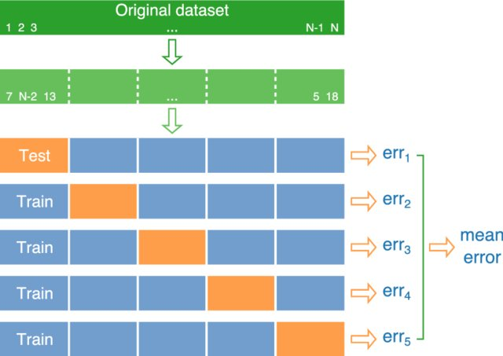
Experiment settings: ten-fold cross-validation
Picture taken from Mariia Fedotenkova‘s thesis

Slide 11
Results

Slide 12
Experiments for Topics: IT and Economics

Slide 13
Results for Topics

Slide 14
Related Work: Author Identification at PAN at CLEF 2011-2019

Slide 15
Related Work:
Translation from Russian (being published in the Journal
"Problems of Transmitting of Information", Vol. 37, №2, - Moscow, 2001)

Slide 16
Related Work:
From conclusion:
. . . It is still amazing that the usage of such a seemingly simple unit as a pair of subsequent letters in the text gives more precise results than the usage of such a language categories as individual grammatical codes and their pairs. Perhaps, letter pairs contain a kind of converted and incomplete information about structure of morphemes of words as they appeared in the text (prefixes, roots, suffixes and inflexions).
Translation from Russian (being published in the Journal
"Problems of Transmitting of Information", Vol. 37, №2, - Moscow, 2001)

Slide 17
Conclusion
The obtained results are comparatively good and demonstrate that we are able to define the author of the text even for short texts, less than 200 words.
The best result was obtained for Russian papers: F-measure of 0.979 using letter based method.

Slide 18
Our future plans:
We plan to experiment with different sizes of text fragments and see how the accuracy of author detection changes;
We are going to explore the publications authored by two authors who are already in our collection of text as single authors of the papers. This allows us to see which part of the text was written by which co-author.

