Slide 1
‘GOD’, ‘NATION’ AND ‘FAMILY’ IN THE IMPEACHMENT OF A BRAZIL’S PRESIDENT: A CORPUS-BASED APPROACH TO DISCOURSE
Rozane Rebechi
Assistant professor
Federal University of Rio Grande do Sul - Brazil
Corpora 2019 International Conference – St. Petersburg – 24-28 June

Slide 2
OVERVIEW
Scene setting
Motivation
Objectives
Theoretical background: political and media discourse
Methodology: corpus-assisted discourse analysis
Concluding remarks
References

Slide 3
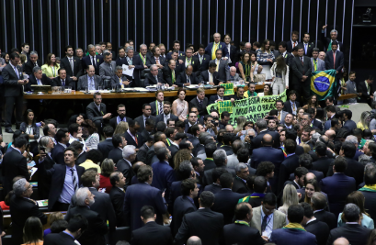
The Lower House voting: 17 April 2016
Voting of left-wing President Dilma Rousseff’s impeachment → breaking fiscal laws in managing federal budget;
Process is sent to Senate → impeachment accepted.

Slide 4
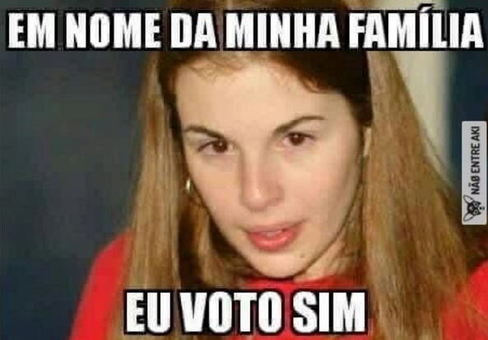
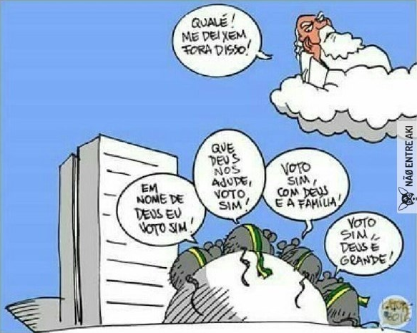
MOTIVATION: MEMES
‘For free wi-fi all over Brazil I vote yes!!!’
‘In the name of my family, I vote yes.’
Rats: ‘In the name of God I vote yes!; May God help us, I vote yes!; I vote yes, God is great!.’
God: ‘Come on! Leave me out of this!’

Slide 5
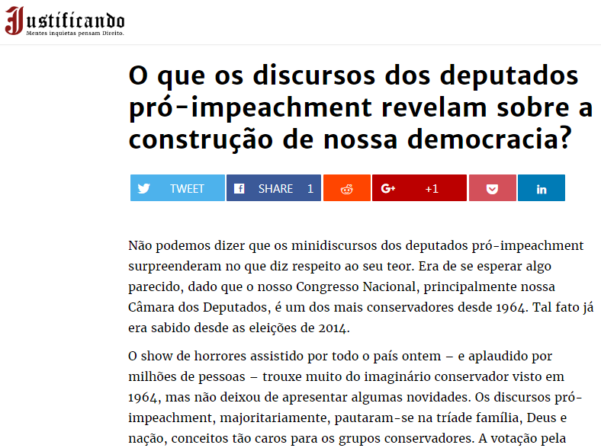
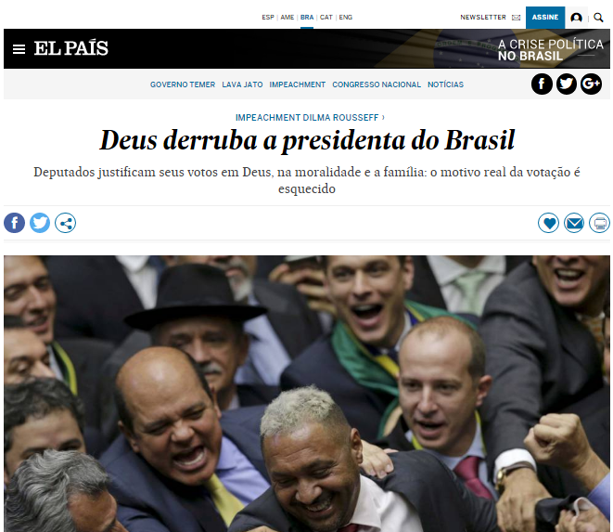
MOTIVATION: MEDIA
God overthrows Brazil’s president
Deputies justify their votes in God, morality and the family: the real motive behind the vote is forgotten
What do pro-impeachment Deputies’ speeches reveal about our democracy?

Slide 6
OBJECTIVES
Research questions:
is the lexical choice used by voters favorable and contrary to impeachment statistically different? If so…
in what degree does this choice differ?

Slide 7
MEDIA DISCOURSE
plays a prominent role in disseminating information;
entails hidden relations of power → constructed from systematizations;
represents discourse → no transparent report of what was said or written, but a decision making based on an interpretation of information (Fairclough 1989).

Slide 8
«Language is necessary to any form of social activity, but politics is arguably the one that relies on language more than most to accomplish its goals» (Romagnuolo 2009: 1)

Slide 9
POLITICAL DISCOURSE
Aims to control people’s minds (Dylgjeri, 2017);
is one of the means used to achieve and maintain hegemonic power (Reys, 2011)
lexical items are chosen to manipulate interlocutors;
seeks legitimization → credibility (Chilton, 2004);
delegitimizes opponents → accusations.

Slide 10
CORPUS-ASSISTED DISCOURSE ANALYSIS
Critique to discourse analysis: supposedly weak method of investigating fragments of texts based on an analyst’s preconceived ideas → cherry picking;
CL → accused of trusting solely on numbers, disregarding a deep manual analysis of data;
CADS → combined with the pragmatism that a corpus-based methodology enables, discourse studies can have its inevitable degree of subjectivity lowered (Partington, 2003).
HGJGJ

Slide 11
STUDY CORPUS: Deputies’ speeches
1.37%
26.81%
71.82%
 | N. of speeches | N. of words (tokens)
YES | 367 | 19,249
NO | 137 | 7,836
ABSTAIN | 7 | 299
Total | 511 | 27,384

Slide 12
METHODOLOGY
WordSmith 7 (Scott, 2016):
Keywords of Y (12 x) and N (5 x)
→ effect-size (log-ratio) ≥ 2.0;
→ statistical significance (log likelihood): score of 6.63 (p < 0.01):

Slide 13
KEYWORDS IN Y AND N
N | Type | F in C1 (19197) | F in C2 (73494035) | RF in C1 | RF in C2 | LL | Log Ratio
1 | Dilma | 58 | 591 | 0,003021 | 8,04E-06 | 566,651 | 8,553497
2 | Rousseff | 14 | 545 | 0,000729 | 7,42E-06 | 100,432 | 6,619773
3 | querida (‘dear’, fem.) | 43 | 1729 | 0,00224 | 2,35E-05 | 305,75 | 6,573073
4 | netos (‘grandchildren’) | 15 | 635 | 0,000781 | 8,64E-06 | 105,148 | 6,498808
5 | cometeu (‘committed’) | 13 | 872 | 0,000677 | 1,19E-05 | 79,441 | 5,834786
6 | voto (‘vote’, noun; verb) | 384 | 26389 | 0,020003 | 0,000359 | 2328,429 | 5,799844
7 | esposa (‘wife’) | 18 | 1609 | 0,000938 | 2,19E-05 | 99,934 | 5,420507
8 | sim (‘yes’) | 393 | 35660 | 0,020472 | 0,000485 | 2170,452 | 5,398897
9 | meus (‘my’, plural masc.) | 99 | 9546 | 0,005157 | 0,00013 | 535,078 | 5,311207
10 | eu (‘I’) | 303 | 29247 | 0,015784 | 0,000398 | 1637,05 | 5,309704
11 | querido (‘dear’, masc.) | 23 | 2584 | 0,001198 | 3,52E-05 | 117,505 | 5,090702
12 | eleitores (‘electors’) | 25 | 3071 | 0,001302 | 4,18E-05 | 123,415 | 4,961894
13 | viva (‘hurray’) | 14 | 1810 | 0,000729 | 2,46E-05 | 67,733 | 4,888112
14 | minha (‘my’, fem.) | 261 | 36216 | 0,013596 | 0,000493 | 1227,252 | 4,786097
15 | você (‘you’, sing.) | 12 | 1696 | 0,000625 | 2,31E-05 | 56,002 | 4,759573
N | Type | F in C1 (7874) | F in C2 (73494035) | RF in C1 | RF in C2 | LL | Log Ratio
1 | jurei (‘(I) swore’) | 7 | 6 | 0,000889 | 8,16E-08 | 110,047 | 13,41064
2 | Dilma | 45 | 591 | 0,005715 | 8,04E-06 | 497,819 | 9,473082
3 | golpistas (‘coupists’) | 10 | 135 | 0,00127 | 1,84E-06 | 110,096 | 9,433355
4 | covardes (‘cowards’) | 10 | 156 | 0,00127 | 2,12E-06 | 107,304 | 9,224769
5 | golpe (‘coup’) | 86 | 1957 | 0,010922 | 2,66E-05 | 859,684 | 8,68008
6 | impeachment | 36 | 828 | 0,004572 | 1,13E-05 | 359,118 | 8,664681
7 | honrada (‘honorable’, fem.) | 8 | 402 | 0,001016 | 5,47E-06 | 67,531 | 7,537191
8 | honesta (‘honest’, fem.) | 9 | 560 | 0,001143 | 7,62E-06 | 72,183 | 7,228885
9 | farsa (‘farce’) | 10 | 733 | 0,00127 | 9,97E-06 | 76,974 | 6,992502
10 | réu (‘defendant’) | 5 | 376 | 0,000635 | 5,12E-06 | 38,235 | 6,955582
11 | hipocrisia (‘hypocrisy’) | 8 | 651 | 0,001016 | 8,86E-06 | 59,932 | 6,841729
12 | lutaram (‘(they) fought’) | 7 | 592 | 0,000889 | 8,06E-06 | 51,909 | 6,786144
13 | cometeu (‘(he/she) committed’) | 9 | 872 | 0,001143 | 1,19E-05 | 64,33 | 6,589984
14 | vocês (‘you’, plural) | 8 | 993 | 0,001016 | 1,35E-05 | 53,283 | 6,232593
15 | Presidenta (‘President’, fem.) | 21 | 3100 | 0,002667 | 4,22E-05 | 132,72 | 5,982508

Slide 14
KEY-KEYWORDS
N | Type | F in Y | Log Ratio in Y | F in N | Log Ratio in N | N | Type | F in Y | Log Ratio in Y | F in N | Log Ratio in N
1 | aqui | 86 | 2,8699402 | 36 | 2,8993127 | 15 | meu(s); minha(s) | 360 [+99+261+13] | 4,4250646 | 44 [+69+5] | 3,5033349
2 | brasileiro(s) | 79 [+51] | 2,2017836 | 29 | 2,0416961 | 16 | nome | 105 | 4,1503809 | 30 | 3,6287383
3 | cometeu | 13 | 5,834786 | 9 | 6,5899835 | 17 | nós | 61 | 2,5604195 | 21 | 2,3077118
4 | contra | 64 | 2,1782299 | 86 | 3,8902069 | 18 | pelo(s); pelas | 337 [+110+25] | 2,766924 | 19 | 2,3224689
5 | corrupção | 47 | 3,82856 | 16 | 3,5596834 | 19 | povo | 192 | 3,4143766 | 54 | 2,8700139
6 | crime | 19 | 2,315987 | 30 | 4,2606624 | 20 | querida(o) | 43 [+23] | 6,5730732 | 5 | 4,1747806
7 | Deus | 49 | 3,8466948 | 7 | 2,3250521 | 21 | respeito | 68 | 3,0130266 | 38 | 3,4592035
8 | digo | 16 | 3,9124266 | 5 | 3,520067 | 22 | responsabilidade | 35 | 2,7620294 | 15 | 2,8253493
9 | Dilma [+Rousseff] | 58 [+14] | 8,5534972 | 45 | 9,4730816 | 23 | ruas | 27 | 4,0859024 | 19 [+5] | 4,8646547
10 | eu | 303 | 5,3097035 | 129 | 5,3634691 | 24 | sou | 19 | 2,7324738 | 21 | 4,1625759
11 | família(s) | 106+18 | 4,4832461 | 8 | 2,0410379 | 25 | você | 12 | 4,7595726 | 8 | 6,2325929
12 | filho(s) | 42+18 | 4,2717867 | 7 | 2,9725365 | 26 | votar | 22 | 2,4650622 | 11 | 2,7507745
13 | fora | 26 | 3,2801971 | 6 | 2,4504322 | 27 | voto(s) | 384 | 5,799844 | 152 [+12] | 5,7485213
14 | homenagem | 32 | 3,6513441 | 28 | 4,7444112 | 28 | vou | 17 | 2,3499745 | 9 | 2,7181489

Slide 15
BEING ALTRUISTIC
Public speakers tend to express their intentions as if not driven by personal interests;
they legitimize their decisions as a response to their voters’ well-being.
YES
‘For the family values; for free and well-mannered men; in respect to my people, of Divinópolis and of all Minas Gerais […].’
NO
‘[…] in defense of the Brazilian people, in the name of Bahia, in the name of my Bahian Southern region, in the name of my city Itabuna.’

Slide 16
ASSUMING AND SHARING RESPONSIBILITIES
first person singular → personal involvement; strategically used to announce good news and to indicate that the speaker’s role is important, his or her decision is individual.
first person plural → induces interpreters to conceptualize group identity, coalitions, parties; shortens the distance between the Self, the speaker and the interlocutor.
YES
'Mr. President, Mrs. and Mr. Deputies, I vote here today in favor of our children […].’
‘If we want to fix Brazil, we need to go until the end.’
NO
'[...] I want here forward the vote no in this process.’
‘And coup, we cannot vote for it.’

Slide 17
APPEALING TO EMOTION/ DELEGITIMIZING
YES
‘Enough of so much corruption!’
‘I vote yes. Dilma out! PT out!’
NO
‘[…] I say no to this ridiculous corruption that shames my Country.’
‘No to the coup. Coupists out!’
Counter-impeachment Brazilians associated the process with the military coup d’état of 1964, when the President was deposed.

Slide 18
RELIGIOUS DISCOURSE
a common practice among politicians;
used to justify policy, support ideological positions, present a public persona, and underline personal ethical appeal and individual moral suitability (Crines & Theakston, 2015).

Slide 19
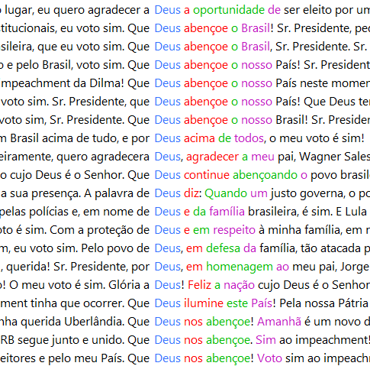
YES
‘May God bless our country, Mr. President.’

Slide 20
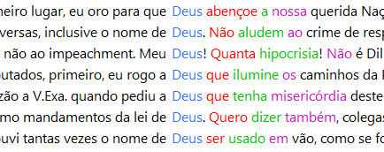
NO
‘[…] never before in my life, in such a short period of time, have I heard God’s name being used in vain so many times […].’
‘My God! How much hypocrisy!’
‘[…] first of all, I pray that God will bless our beloved Nation, Brazil.’

Slide 21
PATRIOTISM
A concept mostly associated with right-wing principles:
YES
‘The nation demands change.’
NO
Ø

Slide 22
CONCLUDING REMARKS
Both Y and N repeatedly resort to (de)legitimization strategies → political rhetoric;
appeal to emotion was observed among N and Y keywords: altruism;
Deus was recurrent in the Deputies’ speeches who voted for and against the process → different contexts;
Patriotism → Y;
crude counting of word hits is not enough to reach generalizations → votes favorable to the process were almost 3 times the unfavorable votes.

Slide 23
REFERENCES
Chilton, P. (2004). Analysing political discourse: Theory and practice. London and New York: Routledge.
Crines, A. S., & Theakston, K. (2015). 'Doing God' in Number 10: British prime ministers, religion and political rhetoric. Politics and Religion, 8 (1). 155 - 177.
Dylgjeri, A. (2017). Analysis of speech acts in political speeches. European Journal of social Sciences Studies, 2(2), 19-25
Fairclough, N. (1989). Language and Power. London: Longman.
Partington, A. S. (2003). The linguistics of political argument: The spin-doctor and the wolf-pack at the White House. London: Routledge.
Reys, A. (2011). Strategies of legitimization in political discourse: from words to actions. Discourse & Society, 22(6), 781–807.
Scott, M. (2016). WordSmith Tools version 7. Stroud: Lexical Analysis Software.

Slide 24
ANY QUESTIONS?
Thank you!
Спасибо
You can find me at
rozanereb@gmail.com

