Slide 1
Creating a sociologically balanced spoken corpus
Marie Kopřivová, Zuzana Komrsková
David Lukeš, Petra Poukarová
Institute of the Czech National Corpus
Charles University, Prague
Corpus Linguistics 2019 26th June 2019

Slide 2
Overview
Type of communication
Czech spoken corpora
The ORTOFON corpus
Balancing the ORTOFON corpus

Slide 3
What type of communication?
in informal situations (mainly dialogues)
in formal situations (longer monological parts)
Special corpora:
corpus of school communication: SCHOLA2010
corpus of TV language: DIALOG
corpus of Czech dialects: DIALEKT

Slide 4
Communication in … informal situations
prototypical spoken language (Čermák)
intimate discourse (Clancy)
common spoken language (Daneš, Chloupek)
the language of everyday spoken dialogues (Hoffmannová)
…
spontaneous language used in informal settings among friends or family members
e.g.: chatting during a meal, visiting friends

Slide 5
… formal situations
controlled dialogue
quasi-spontaneous language (Russian spoken corpus: interview,
unprepared monologue)
Characteristics: opinion poll with general questions
e.g. What do you think of the roles of men and women in contemporary society?
What do you think about contemporary education?
The interviewer and interviewee did not know each other
The purpose – language research – was concealed

Slide 6
CZECH SPOKEN CORPORA
Notes:
6

Slide 7
Czech spoken corpora CNC
Corpus | Time span | Region | Total hours of audio
PSC | 1988–1996 | Prague | cca 70
BSC | 1994–1999 | Brno | cca 55
ORAL | 2002–2011 | Czech Republic | 582
ORTOFON | 2012–2017 | Czech Republic | 103

Slide 8
The first corpus of spoken Czech
Prague spoken corpus (1988–1996)
Čermák et al. 2001
speakers only from Prague (674,992 words)
balanced proportions of:
gender (female x male)
age (18–34 years old x over 35 years old)
education (non-tertiary x tertiary)
type of situation: formal x informal
one-tier transcription – folklore / literary

Slide 9
Brno spoken corpus
(1994–1999)
Hladká 2002
speakers only from Brno (500,460 words)
same criteria as PSC

Slide 10
ORAL
 | Time span | Region | Tokens
ORAL2006 | 2002–2006 | Bohemia | 1,000,798
ORAL2008 | 2002–2007 | Bohemia | 1,000,097
ORAL2013 | 2008–2011 | Czech Republic | 2,785,189
ORAL-Z | 2002–2007 | Bohemia | 623,688

Slide 11
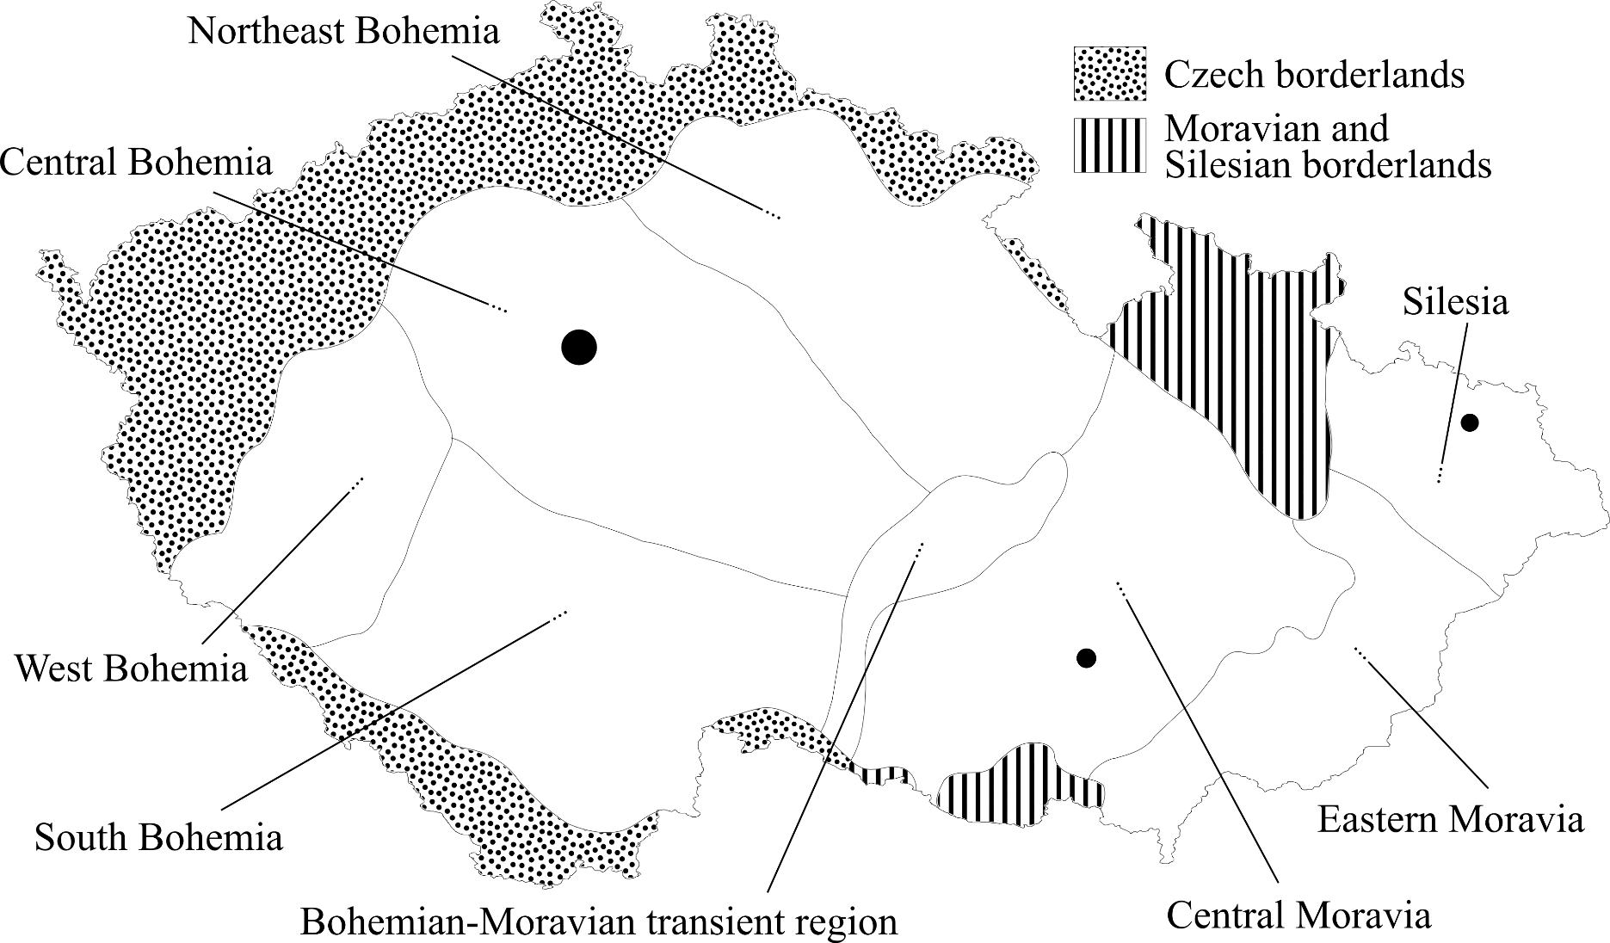
Map

Slide 12
The ORAL corpus
(2002–2011), informal situations
6 mil. running words, 582 hours, 1,546 recordings
unbalanced corpus
speaker characteristics:
gender, age , education
+ region of childhood residence
speakers from the whole Czech Republic
ORAL2013 + ORAL-Z: + transcription is sound-aligned

Slide 13
Balancing the spoken corpora
PSC and BSC approximately balanced in 3 categories
ORAL 2006 non-balanced
ORAL 2008 approximately balanced
gender
age
education
+ 4 regions of residence up to the age of 15
ORAL 2013 approximately balanced
9 regions of residence up to the age of 15
Notes:
The idea: applied to the collection of material for all of the ICNC spoken corpora
A minimum of 5 speaker should also minimize the influence of idiolect

Slide 14
THE ORTOFON CORPUS
Notes:
14

Slide 15
The ORTOFON corpus
(2012–2017)
624 different speakers within 332 recordings, 103 hours
transcription is sound-aligned (using ELAN)
speakers from the whole Czech Republic
NEW:
multi-tier transcription: orthographic, phonetic, metalinguistic
more detailed characteristics of speakers (e.g. career, relationship between speakers)

Slide 16
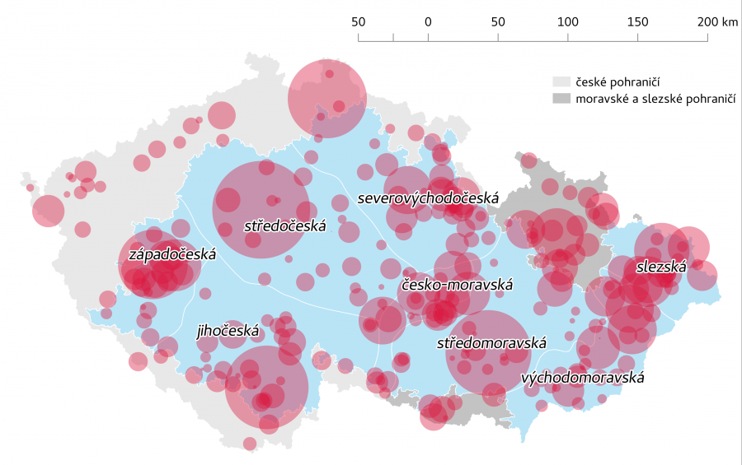
Map
Notes:
Red dots show the places from which the speakers within the ORTOFON corpus come out

Slide 17
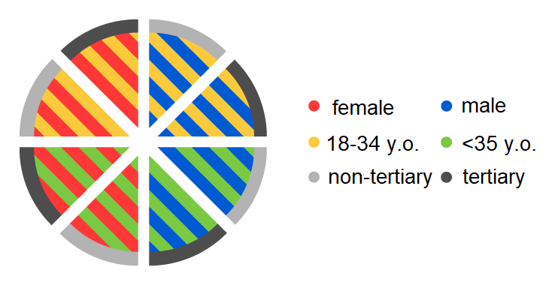
Balancing the ORTOFON corpus (I)
- fully balanced with respect to
gender, age, education, region of childhood
residence (up to the age of 15)
>

Slide 18
Balancing the ORTOFON corpus (II)
basic concept: the same proportional representation of each category of speakers based on the 4 key sociolinguistic characteristics
target corpus size: 1 mil. words
the target for every category represented by the combination of four variables:
gender (2) × age (2) × education (2) × region of residence up to the age of 15 (10) = 80 categories
1 mil. words / 80 categories = 12 500 words per cat.
+ condition: the highest possible speaker variability within the scope of each category => a minimum of 5 different speakers
Notes:
The idea: applied to the collection of material for all of the ICNC spoken corpora
A minimum of 5 speaker should also minimize the influence of idiolect

Slide 19
Balancing the ORTOFON corpus (III)
the implementation of the concept during data collection
the selection problem:
choose an initial “seed” recording at random
add another recording: picking the recording which maximally differs from the current composition of the corpus in terms of the relevant sociolinguistic variables
repeat step 2 until the target size of the corpus (1m words) is reached
generate as many variants of the corpus as possible (thousands) by repeating steps 1–3
define an objective function (fulfilling the stipulated balancing criteria)
select the best solution
Notes:
The selection problém: the required speakers are mixed within different recordings
5) Obj funkction which quantifies how badly any given corpus variant fails at fulfilling the stipulated balancing criteria
6) + determine the best / least bad solution from the pool of corpus variants generated in step 3, and select that as the final composition of the corpus

Slide 20
Summary
overview of Czech spoken corpora
our approach to balancing the ORTOFON corpus as an inspiration
select the main variables before data collection + set their values
balancing the corpus should start during data collection so as to identify categories where data is scarce and focus on them

Slide 21
Thank you for your attention!
Marie.Koprivova@ff.cuni.cz
Zuzana.Komrskova@ff.cuni.cz
This research resulted from the implementation of the Czech National Corpus project (LM2015044) funded by the Ministry of Education, Youth and Sports of the Czech Republic within the framework of Large Research, Development and Innovation Infrastructures

