Slide 1
The choice of verbs in Czech as a foreign language textbooks
Pavlína Vališová
Masaryk University, Brno

Slide 2
Introduction
small specialized corpora
7 textbook of Czech as a foreign language (elementary level)
corpus-driven analysis of vocabulary in Czech textbooks
the choice of verbs
the distribution of perfective and imperfective verbs

Slide 3
Traditional textbook analysis
page by page
Czech as a foreign language: most of the analyses are theses
monographs: M. Hrdlička (Prepositions, 2000; Grammar, 2010)
2 tendencies in CFL textbooks:
overestimation of grammar
oversimplification of language

Slide 4
Pedagogical corpora
indirect use of corpora in language teaching
TeMa – A corpus of English as a foreign language textbooks (Gouveneur – Meunier, Louvain)
Corpus of texts in EFL textbooks for Germans (Römer, Cologne)
research: textbook language, instructions, presentation of grammar, spoken and written variants, types of exercises etc.

Slide 5
The choice of vocabulary in Czech textbooks
CFL textbooks tend to simplify the language as much as possible
avoid perfective verbs at lower levels
some perfective verbs belong to the most frequent vocabulary: přijít, zapomenout, zůstat etc.
Which verbs should we present on elementary level? Should we present perfective verbs on A1 level already?

Slide 6
The description of A1 level for Czech
Common European Framework for Languages (CEFR)
A1 level – almost any grammar
“use simple phrases and sentences to describe where I live and people I know”
Czech – grammatical minimum (Cvejnová)
present, past and future of imperfective verbs; perfective verbs individually

Slide 7
Corpus of Czech as a foreign language textbooks (UcKo-A1)
7 contemporary textbooks
(published after 2005; refer to CEFR)
scanned, converted pdf to txt, cleaned
includes only texts, dialogs and model sentences (almost 62 000 tokens)
Sketch Engine tool
list of lemmas, verbs sorted manually

Slide 8
The verbs in elementary textbooks
124 verbs; 21 perfective verbs (17%)
presented in 1 or 2 forms (usually in a phrase):
imperative
infinitiv (after a modal verb)
past tense
future (a phrase)

Slide 9
imperative:
Promiňte, jak se to píše?
Pojďte dál a posaďte se.
infinitive:
Dobrý den, potřebuju opravit boty.
Můžete mi pomoct, prosím Vás?
Nemůžete přijít zítra?
past tense:
Jan se narodil 13.5.1980.
Němcová umřela v roce 1862.
perfective future (a phrase)
Vezmu si čtyři rohlíky.
Dobře, sejdeme se tam v 7.10.

Slide 10
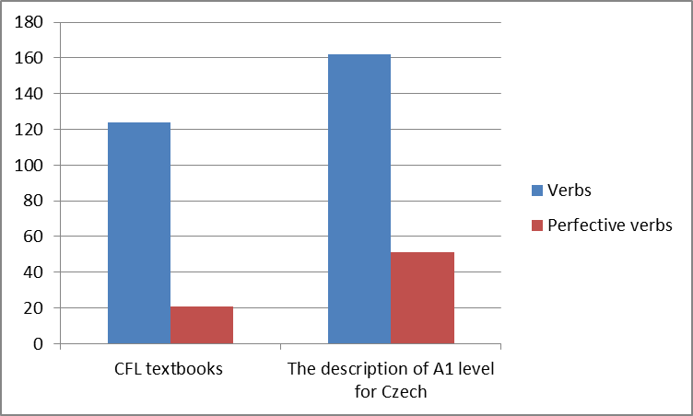
The choice of verbs in A1 level CEFR description (2005)

Slide 11
The frequency of selected verbs in A1 in Czech National Corpus
comparison with Czech National Corpus
SYN2010 – written representitive corpus, 100 mil tokens
2 verbs from the descriptor:
proclít, zamluvit
2 verbs from the textbooks:
přijít, říct

Slide 12
Proclít = to clear sth through customs
only 16 tokens
more frequent is a noun proclení
phrase: Máte něco k proclení?
unsuitable for A1 level?
Is a dialog in the customs part of the sylabus?

Slide 13
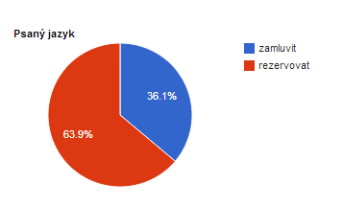
Zamluvit X rezervovat = to reserve (e.g. a table)

Slide 14
Přijít = to come
one of the most frequent verbs (almost 80 000 tokens in written corpus)
included in 2 books only
students already know the verb jít on this level
most frequent forms:
past tense: přišel
future: přijde

Slide 15
Říct = to say
included in every textbook form the corpus
past tense only in one (Česky v Česku II)
most frequent form in national corpus is past tense: řekl/a
textbooks often present dialogs

Slide 16
Conclusion
textbooks avoid using perfective verbs
discrepancies in CEFR description of A1 level and the textbooks
many perfective verbs were presented only in one verb form to memorize (imperative, infinitive, past tense)
national corpus is an exellent assistance in choosing the most frequent verb form and suitable context
elementary level can benefit from corpus data

Slide 17
Textbooks
Adamovičová, A. – Ivanovová, D. Basic Czech I. Praha, 2007
Cvejnová, J. Česky, prosím. Praha, 2011
Hádková, M. Čeština pro cizince a azylanty A1. Brno, 2005
Holá, L. Čeština Express 1, 2. Praha: 2010
Matula, O. Český den. Praha, 2007
Štindl, O. Easy Czech Elementary. Praha: 2008
Štindlová, B. Česky v Česku 1, 2. Praha, 2008.

Slide 18
References
Bernardini, S. Corpora in the classroom. An overview and some reflections on future developments.
In J. Sinclair. How to Use Corpora in Language Teaching. Amsterdam: 2004, pp. 17–36.
Cvejnová, J. et al. Metodika přípravy ke zkoušce z českého jazyka pro žadatele o trvalý pobyt (úroveň A1), 2010.
Cvrček, V. et al. Mluvnice současné češtiny. Praha, 2010, pp. 245.
Gabrielatos, C. Corpora and language teaching: Just a fling, or wedding bells? In: TESL-EJ, 2005, vol. 8/4, A1, pp. 1–37.
Gouveneur, C. – Meunier, F. New types of corpora for new educational challenges. In K. Aijmer (ed.) Corpora and Language Teaching. Amsterdam, 2009.
Hádková, M. – Línek, J. – Vlasáková, K. Čeština jako cizí jazyk. Úroveň A1, 2005.
Hrdlička, M. Předložky ve výuce češtiny jako cizího jazyka. Praha. 2000.
Hrdlička, M. Gramatika a výuka češtiny jako cizího jazyka. Praha. 2010.
Huston, S. Corpora in Applied linguistics. Cambridge: 2004.
Römer, U. A corpus-driven approach to modal auxiliaries and their didactics. In: J. Sinclair (ed.) How to Use Corpora in Language Teaching. Amsterdam, 2004, pp. 185–199
Römer, U. Corpora and language teaching. In A. Lüdeling – M. Kytö. Corpus Linguistics: an international handbook. Berlin, 2008
Römer, U. Looking at looking: Functions and contexts of progressives in spoken English and 'school' English. In A. Renouf – A. Kehoe (eds.). The Changing Face of Corpus Linguistics. Amsterdam: 2004.
The Common European Framework in its political and educational context. Accessible at: http://www.coe.int/t/dg4/linguistic/source/framework_en.pdf
European Levels – Self Assessment Grid. Accessible at:
Vališová, P. Korpus jako zdroj dat systémového popisu české konjugace při výuce češtiny jako cizího jazyka. Brno, 2009. Accessible at: http://theses.cz/id/qw5wz5

